Slide 1
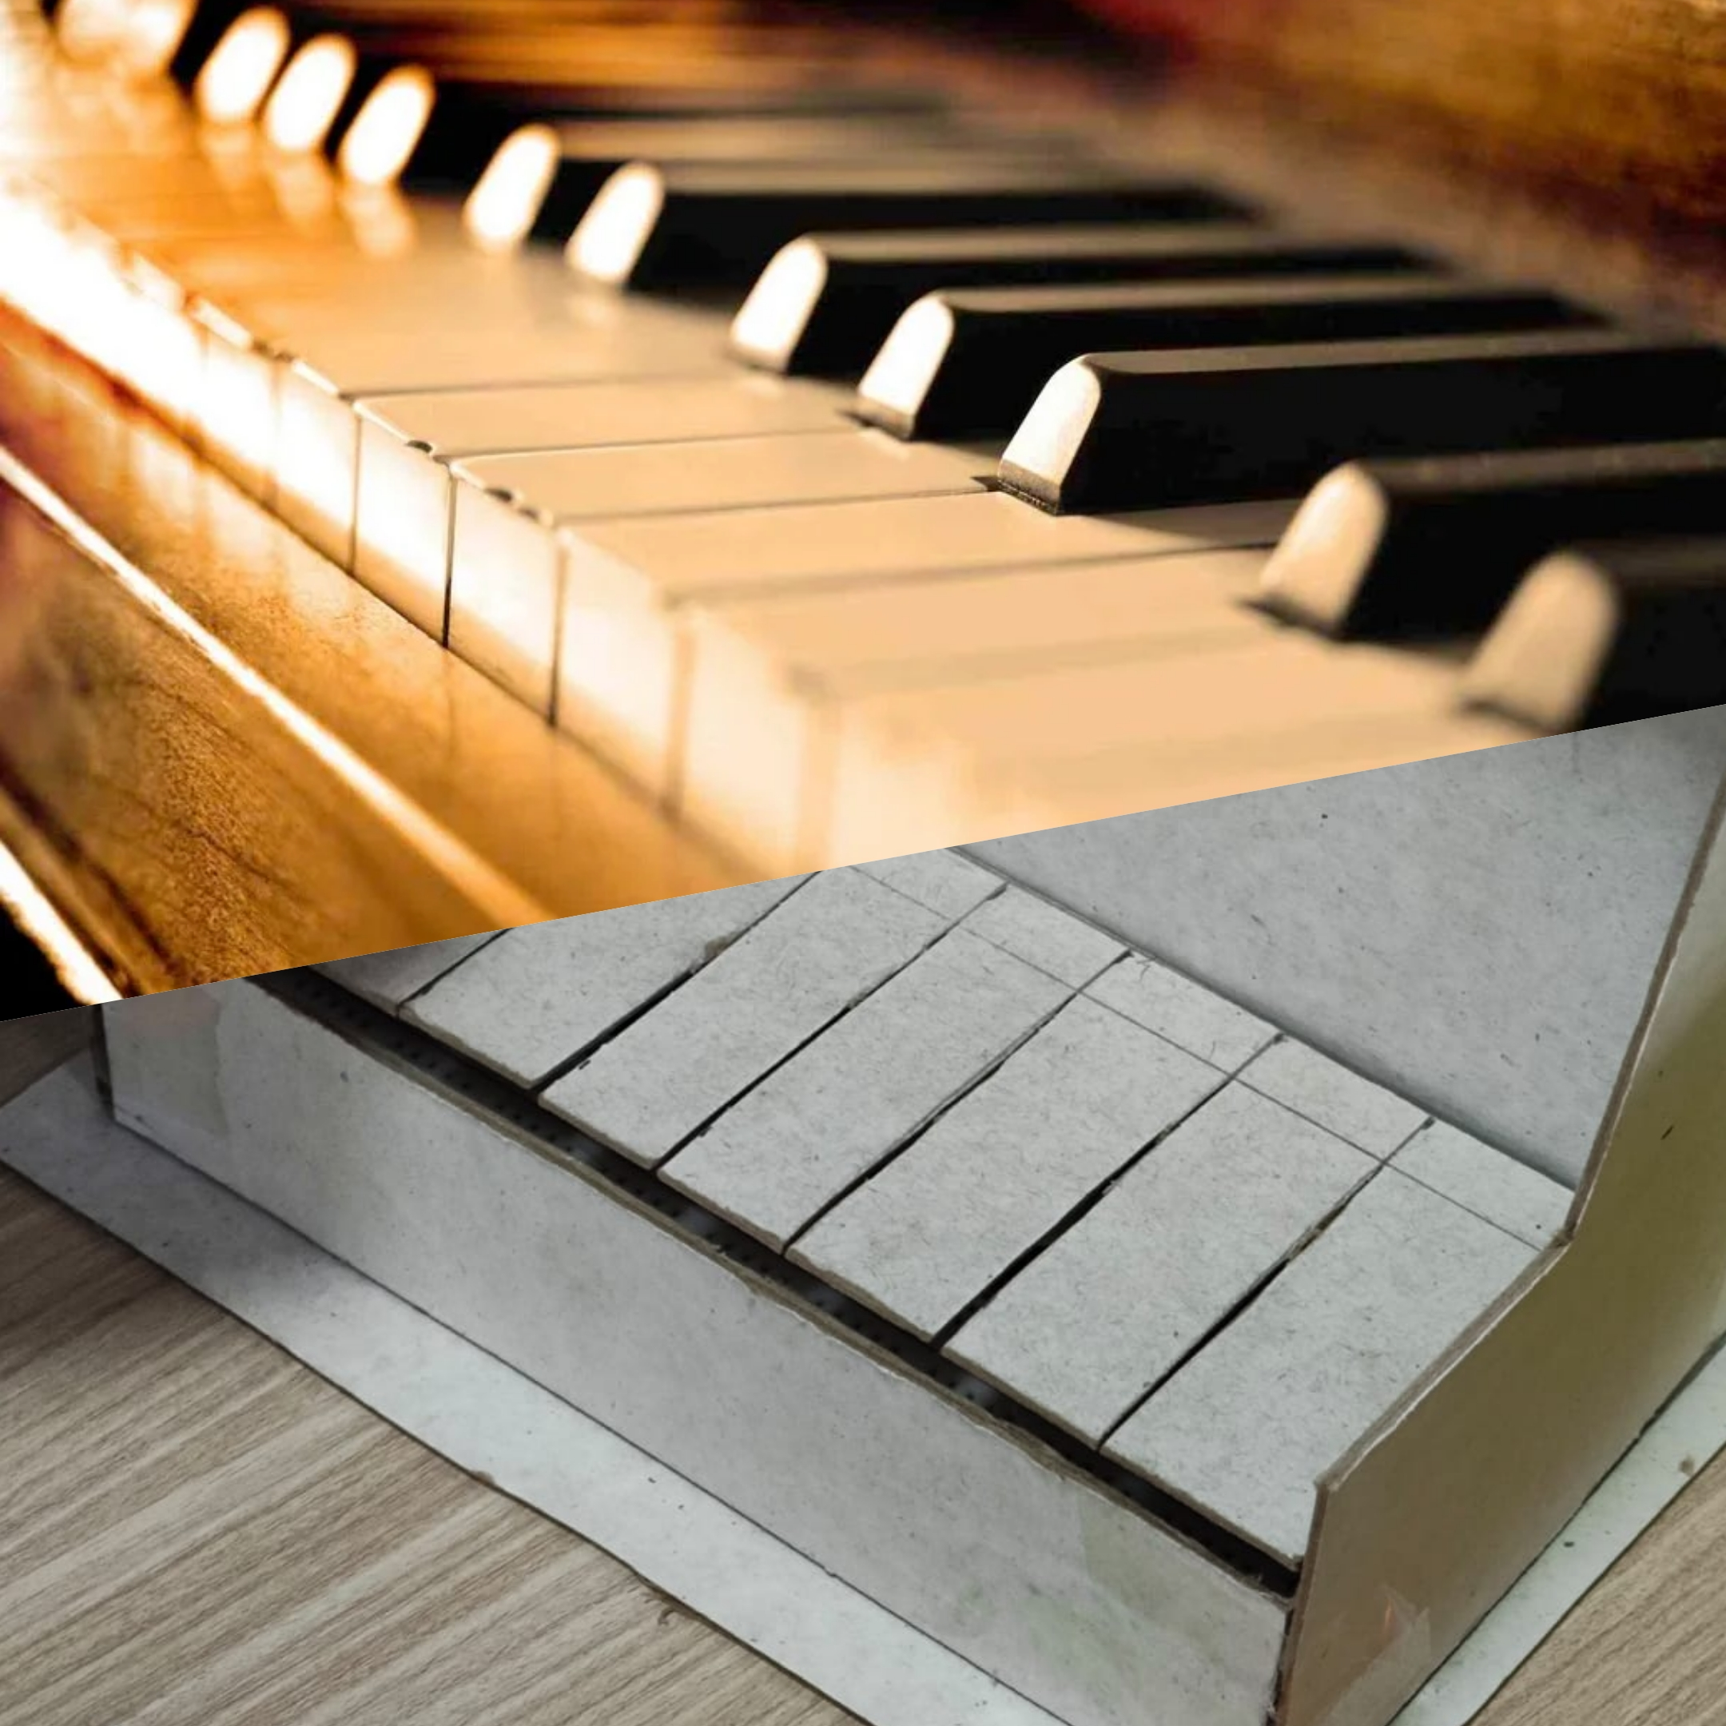

Introduction to Retro Piano Game
An overview of the innovative Retro Piano Game project built on Arduino

Slide 2
In this presentation, we will introduce you to our innovative project, the Retro Piano Game, built on Arduino.
Game: This game is a mini version of a piano, with 9 keys that produce different sounds through a buzzer. You can play the piano by pressing the keys, or switch to different modes that offer more challenges and fun.

Slide 3
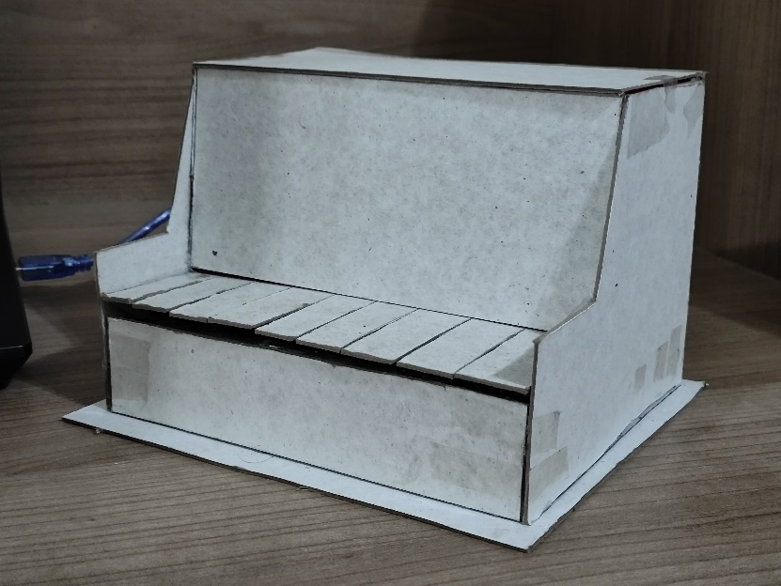
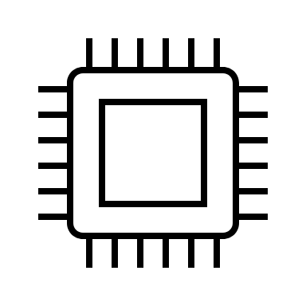

Content
1) What is retro piano game?
2) How does it work?
3) Code
4) Circuit
5) Aim of the project
6) Who supports this project?
«Our lovely retro piano»

Slide 4
1)What is Retro Piano Game?
A mini version of a piano with 9 keys
Can be played by pressing the keys
Produces different sounds through a buzzer
Offers different modes for challenges and fun

Slide 5
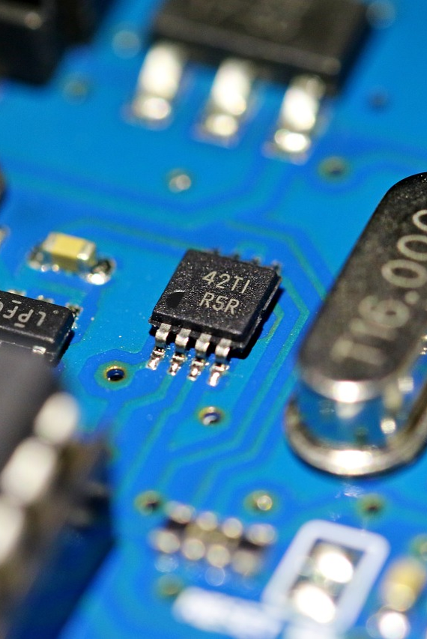
2)How does it work?
Three modes available: Free Play, Note Guessing Game and Music Player.
FREE PLAY: Unlimited creativity and musical expression
NOTE GUESSING GAME: Repeat random sound sequences
MUSIC PLAYER: Follow pre-loaded melodies

Slide 6
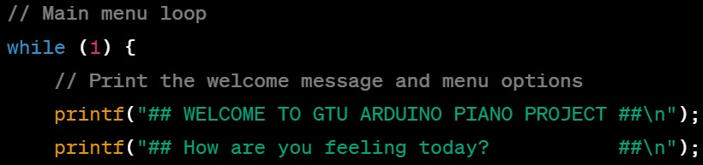
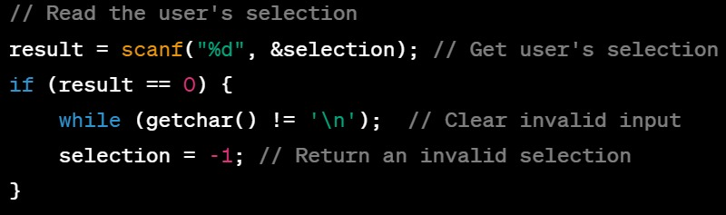
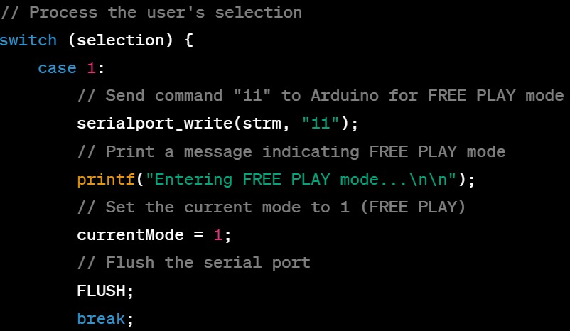
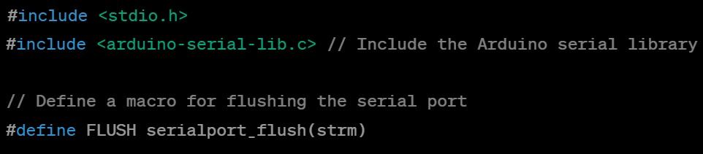
3)Code
C code
User interface was written in c code . At this part, users make their selections and are informed about the current situation.

Slide 7
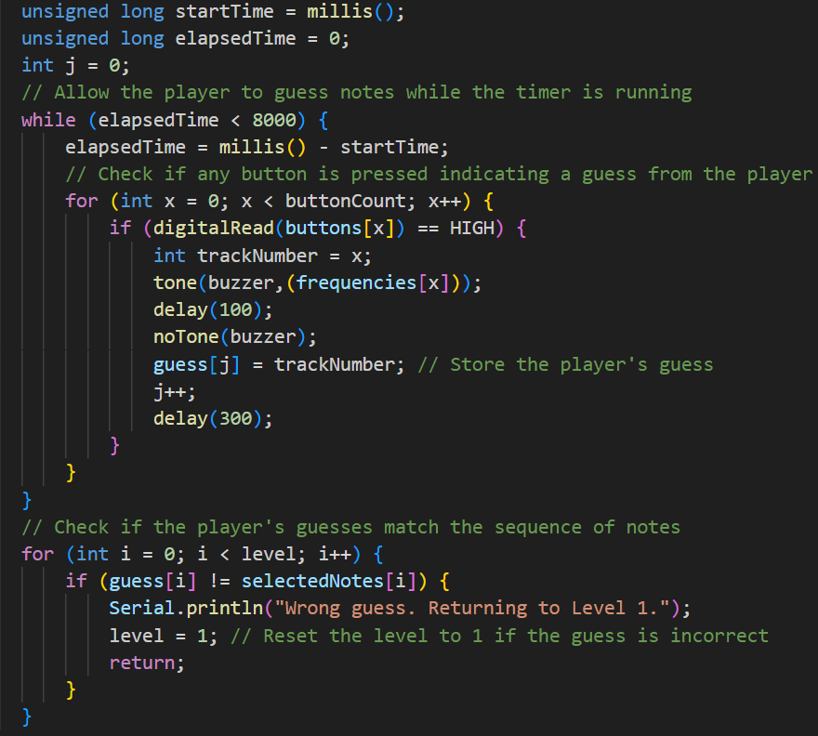
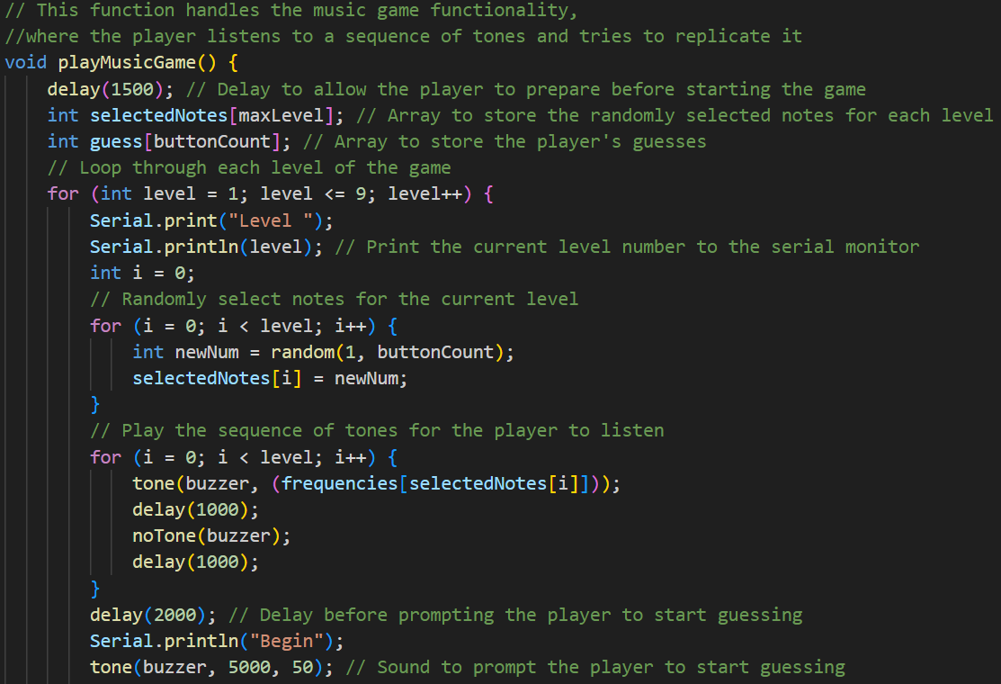
Arduino code
This section contains the main loop of the music game and the mechanism for checking if the user has played the correct notes.
The whole system was built with Arduino code aside from menu interface.

Slide 8
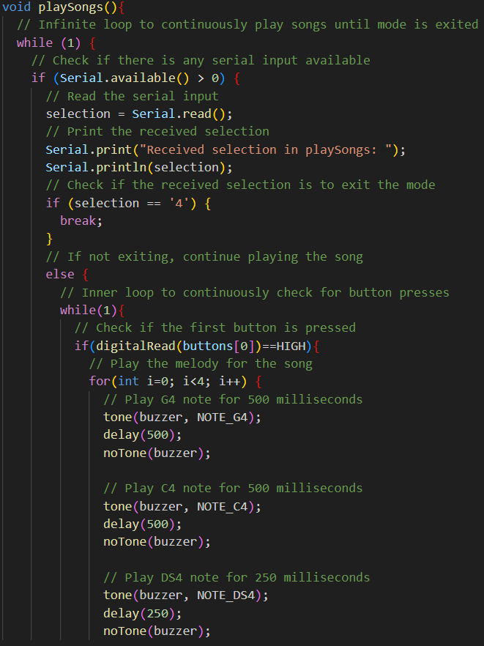
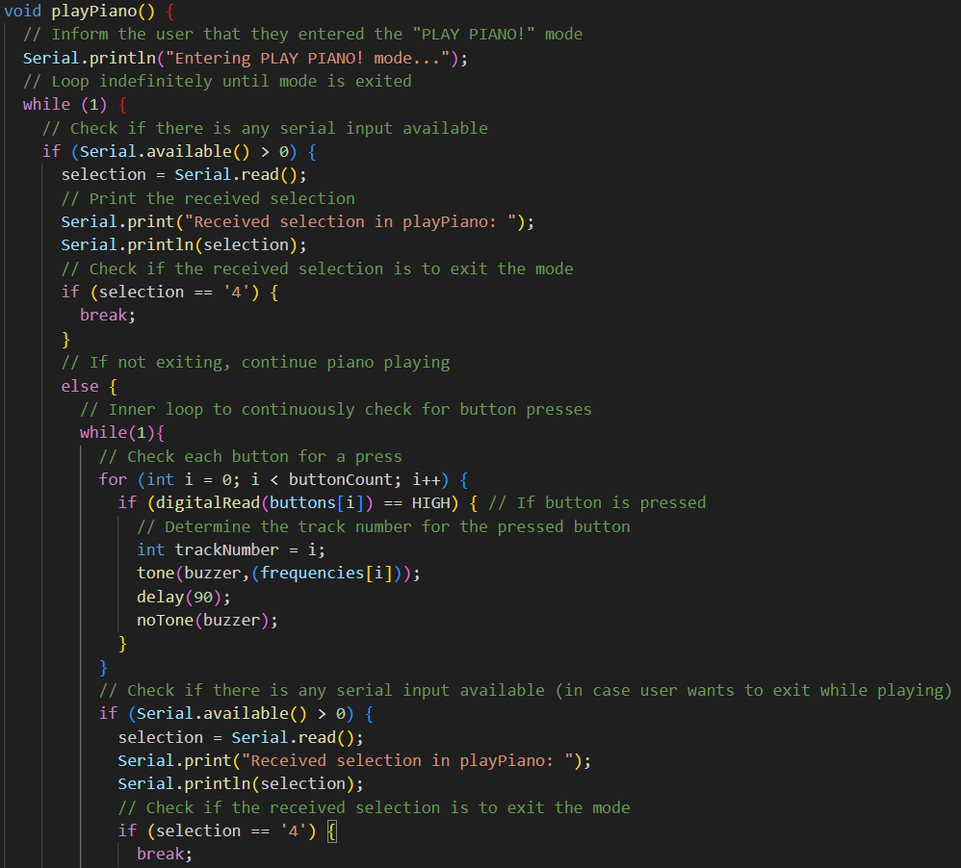
These lines of code are the part that runs the other two modes.

Slide 9
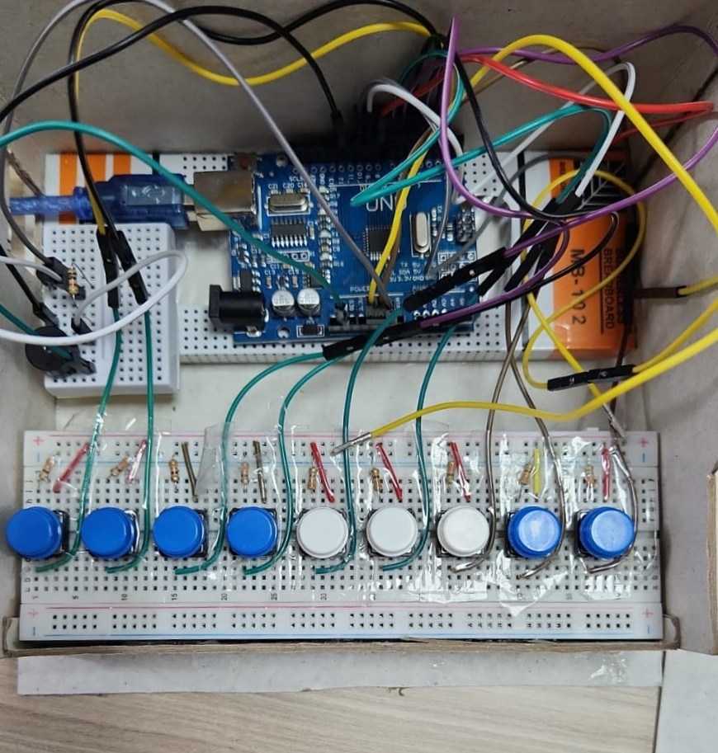
4)Circuit
Equipment
Connections

Slide 10
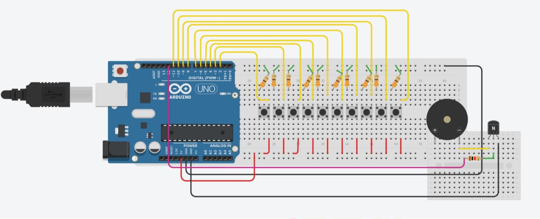
4)Circuit
Breadboard
Jumper cables
Power source
Arduino uno
Buttons
Resistors
Transistor
Buzzer

Slide 11
5)Aim of the Project
The aim of our project is to create a game that is not only entertaining but also educational. The Retro Piano Game has several benefits for the users and the society.
FUN
MENTAL DEVELOPMENT
SOMETHING UNIQUE

Slide 12
Fun
Enjoying free play experience
Listening to beautiful sounds
Challenges user with different modes

Slide 13

Mental Development
Helps developing auditory and cognitive abilities
Improve memory and attention span
Enhances musical appreciation and expression

Slide 14
Why is it unique?
Combines piano and game features
Utilizes Arduino as a platform
Showcases programming skills, circuit design, and sound engineering

Slide 15
6)Who supports this project?
♦ Members of Group 7♦
SELİM BARUT
EMRE KAAN ŞAHİN
YUSUF EREN NALBANT
AYŞE FEYZA SERBEST
MERT CANOĞLU
MEHMET BAHA KESKİN
İREM AKŞUN
BATUHAN YANAR
SULTAN AZİZE KURU
YUSUF ALPEREN ÇELİK

Slide 16
Thank you for your time and attention

